Slide 1
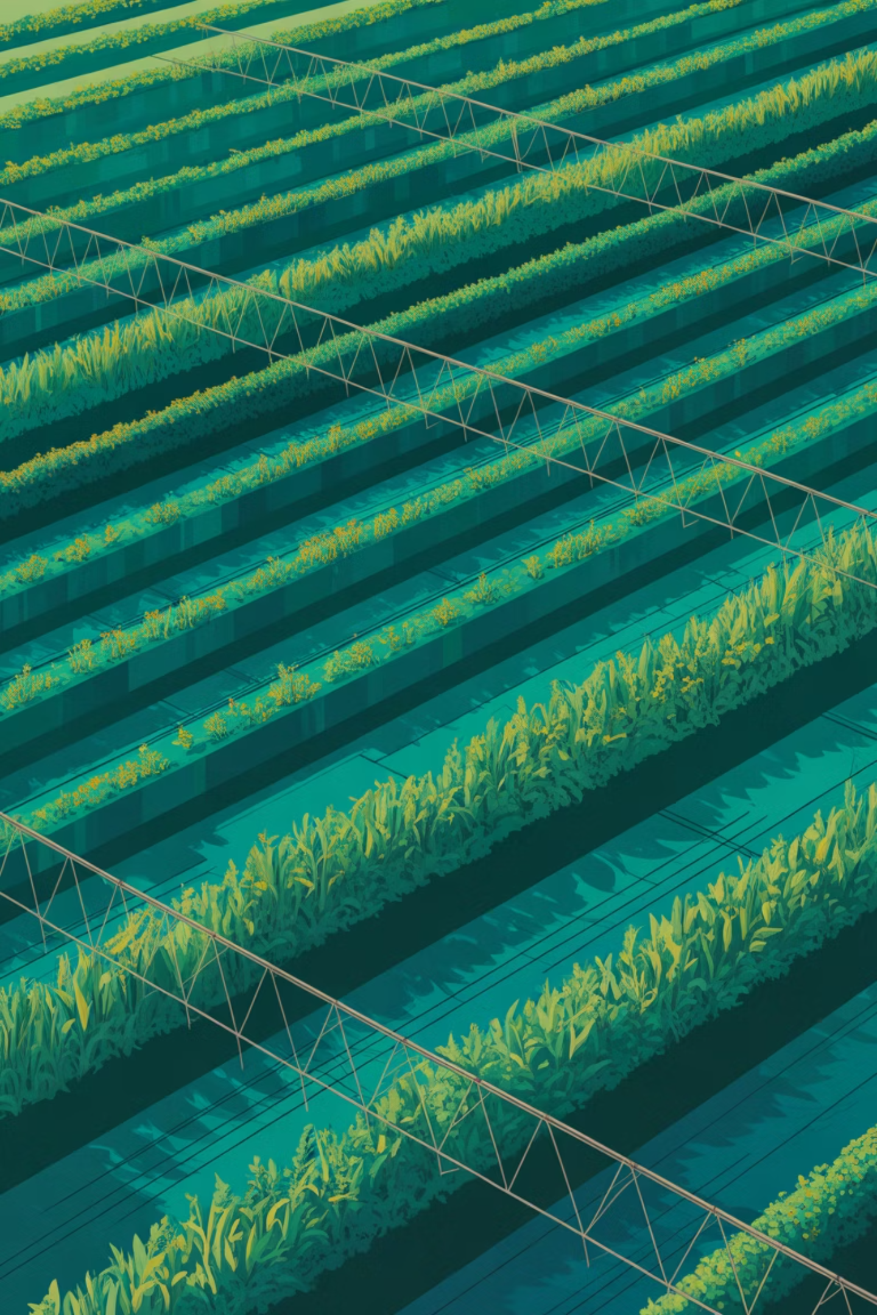
Smart Water Requirement Calculator for Crops
An AI-powered solution for efficient and sustainable irrigation planning in agriculture

Slide 2
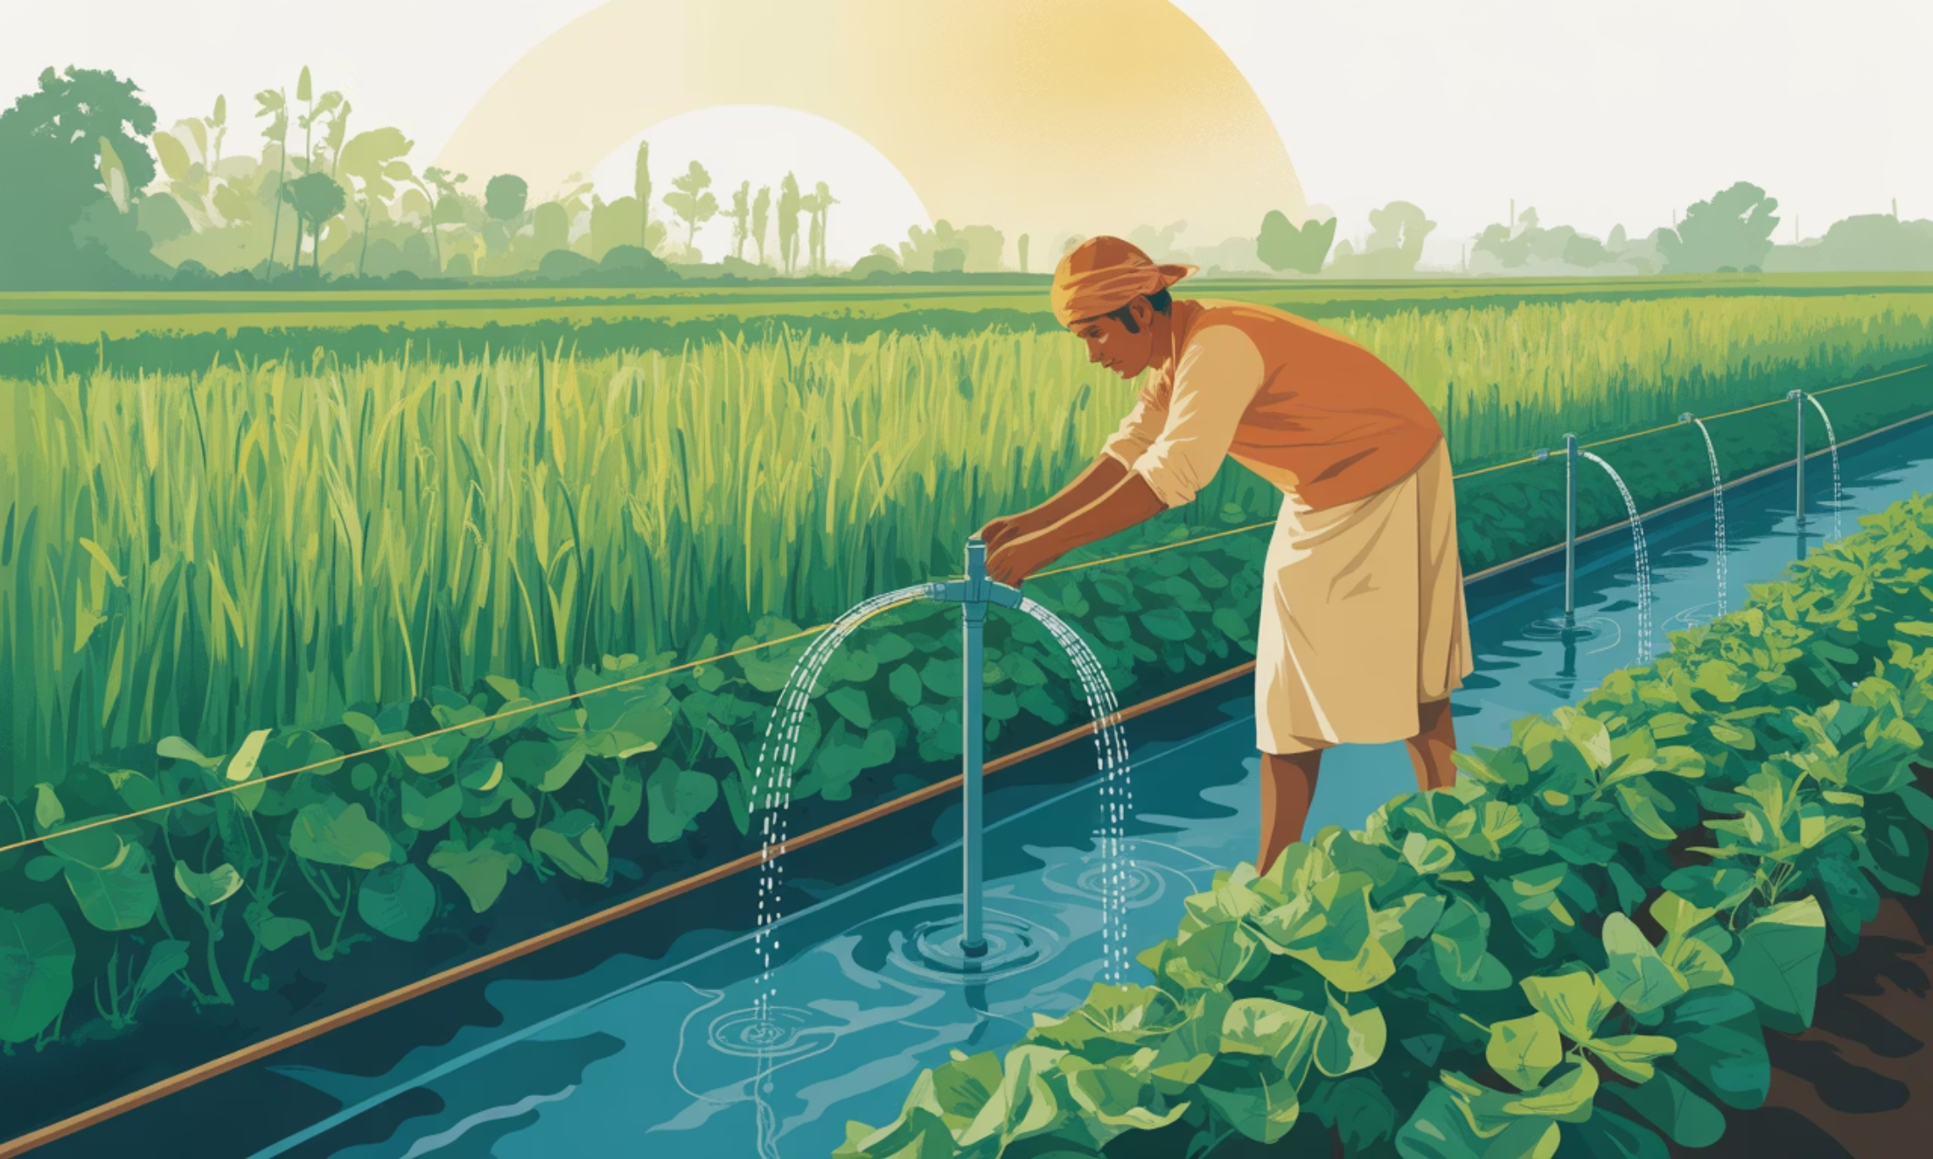
The Water Challenge in Agriculture
Agriculture accounts for nearly 70% of global freshwater consumption, making it the largest water user worldwide. Despite this significant demand, many farmers continue to rely on traditional methods and guesswork rather than data-driven approaches.
Improper irrigation practices result in substantial water wastage, increased electricity costs for pumping, and ultimately, reduced crop yields. The gap between potential and actual productivity remains wide due to inefficient water management.
This project bridges that gap with a smart, technology-enabled irrigation planning solution.

Slide 3

Understanding the Problem
Unknown Requirements
One-Size-Fits-All Approach
Farmers lack precise knowledge about exact water needs for different crops at various growth stages
Same irrigation methods applied regardless of crop type, soil conditions, or climate variations
Ignores Local Factors
Consequences
Weather patterns, rainfall data, and regional differences are rarely considered in irrigation planning
Over-irrigation wastes resources whilst under-irrigation stunts growth and reduces yields

Slide 4
Our Solution: Smart Water Calculator
A data-driven irrigation recommendation system that calculates optimal water requirements by considering crop characteristics, soil properties, weather conditions, and regional rainfall patterns. The calculator provides daily irrigation recommendations tailored to specific field conditions.
01
02
03
Crop Type & Stage
Soil Analysis
Weather Data
Growth phase and water needs
Soil type and water retention
Temperature and evaporation
04
05
Rainfall Adjustment
Daily Recommendation
Precipitation offset
Optimal irrigation volume

Slide 5





How the System Works
Farmer Input
Enter crop type, field area, soil type, and location details
Data Processing
System applies predefined agricultural datasets and formulas
Factor Adjustment
Applies corrections for soil, weather, and regional variations
Rainfall Deduction
Subtracts recent precipitation from total water requirement
Irrigation Output
Displays precise daily water recommendation in litres or gallons

Slide 6
Key Features
Intuitive Interface
Rainfall Integration
Simple, farmer-friendly design requiring minimal technical knowledge
Automatically reduces irrigation needs based on recent precipitation data
Multiple Crop Support
Scalable Design
Comprehensive database covering major crops grown across different regions
Equally effective for small family farms and large commercial operations
Soil Type Coverage
Multi-Platform Access
Accounts for various soil textures from sandy to clayey compositions
Accessible via mobile phones, tablets, or desktop computers

Slide 7
Technologies Used
Lovable / Gamma
Replit Platform
Data Handling
AI-assisted interface design and application generation for rapid prototyping
Cloud-based development environment for logic implementation and testing
Base44 for structured data management and storage operations
Programming Logic
Data Sources
Python and JavaScript for calculation algorithms and user interaction
Open agricultural datasets combined with farmer-provided field information

Slide 8
Market Scope & Applications
Individual Farmers
Agricultural Advisors
Small and medium-scale farmers seeking to optimise water usage and improve yields
Consultants and agronomists providing irrigation recommendations to clients
Irrigation Startups
Government Departments
Smart agriculture companies integrating water calculation into broader solutions
Agriculture ministries and water resource management agencies
Educational Institutions
Water-Scarce Regions
Agricultural universities and research centres for teaching and extension services
Areas facing drought conditions or limited freshwater availability

Slide 9
Advantages & Limitations
✓ Advantages
⚠ Limitations
Resource Conservation
Average Data Values
Significantly reduces water and electricity consumption through precise irrigation
Uses standard agricultural datasets rather than hyper-local measurements
Yield Improvement
No Real-Time Sensors
Optimal watering leads to better crop growth and increased harvest productivity
Currently lacks integration with IoT soil moisture or weather sensors
Manual Entry
User-Friendly
Requires farmer to input data rather than automatic data collection
Simple interface requiring no technical expertise or complex training
Cost-Effective
Affordable solution accessible to farmers across different economic segments

Slide 10
Future Vision for Sustainable Agriculture
Current State
Mid-Term
Data-driven calculator providing irrigation recommendations based on farmer inputs
Real-time weather API integration for dynamic adjustment to changing conditions
1
2
3
4
Near Future
Long-Term
IoT soil moisture sensors providing real-time field data automatically
AI-powered predictive system using machine learning for crop water needs
The Smart Water Requirement Calculator represents a significant step towards sustainable and data-driven agriculture, empowering farmers to make informed irrigation decisions and conserve precious water resources for future generations.

